Slide 1
CSS
MCNDHS
Ms. Eng

Slide 2
aim: How to center boxes
Do now:
Daily Grade:
On-time/attendance/not leaving the classroom: 25%
Cellphones: 25%
Notes:25%
Classwork/Homework: 25%

Slide 3
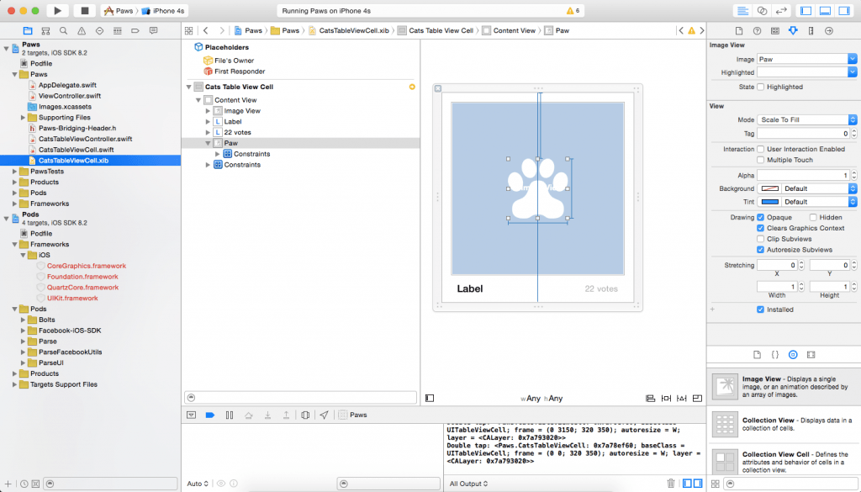
where you see it:

Slide 4
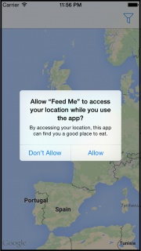
another example:

Slide 5
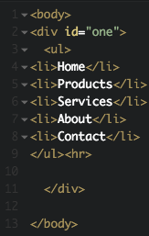
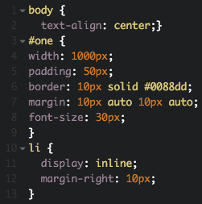
margin auto
HTML

Slide 6

result:

Slide 7

you try!

